Slide 1
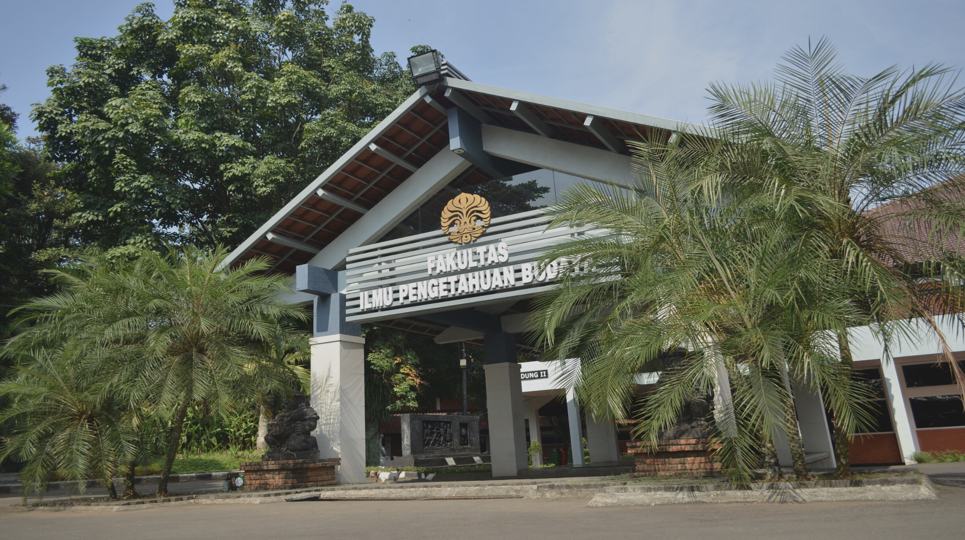

Indonesia-Korea Connectivity Hub (C-Hub) Project: Strategic Planning Workshop
Faculty of Humanities Universitas Indonesia
Team Presentation for KOICA

Slide 2
The Stages of Capacity Building of The ICT-Based Integrated Knowledge System Development (C-Hub Connectivity) at Universitas Indonesia
Signing of the RoD between KOICA and UI, represented by the MoECRT
Performance Management Expert, Dr. Kim Aaron Visited UI for capacity building on RBM and Action Plan for C-Hub and MOOC Development
Signing of the RoD
Technical Assistant Visit
29 August 2022
13—21 December 2022
6—13 November 2022
13—17 February 2023
Kick-Off Survey
Strategic Planning Workshop
Project Manager, Dr. Jong-Dae Park, Assistant Manager, Mr. Cho Hyun Min, and Performance Management Expert Dr. Kim Aaron visited UI for site survey.
Designing the new MOOC program of UI C-Hub

Slide 3
Kick-Off Survey
Project Manager, Dr. Jong-Dae Park, Assistant Manager, Mr. Cho Hyun Min, and Performance Management Expert Dr. Kim Aaron visited UI for site survey
Assess factors and conditions that may affect the project implementation and outcomes to update and elaborate on the project implementation plan
Assess factors and conditions
Revise a result framework for result-based management (RBM)
Revise a result framework
Identify risk and develop the performance management plan including risk management measures
Identify risk
Form Joint Coordinating Committee through consultation with key stakeholder
Form Joint
Coordinating Committee
Draft the contract of the ICT-based Integrated Knowledge Center Establishment Project in UI
Contract Drafting

Slide 4
Technical Assistant Visit
Improve awareness of RBM (Result-based Management of International Development Program) among PIU members and FIB leadership
Performance Management Expert, Dr. Kim Aaron Visited UI for capacity building on RBM and Action Plan for C-Hub and MOOC Development
Develop UI’s own result framework for C-Hub Project with emphasis on RBM
Develop the action plan (activity plan for 2023 based on the overall project implementation plan), especially for MOOC development committee, MOOC development guideline, MOOC’s development timeline for 2023, 1st invitational training
Develop M&E framework for FIB to collect and manage relevant data systematically
Develop the joint baseline survey plan

Slide 5
Strategic Planning Workshop
Create common understanding
Define target groups and their needs
Set the goals and objectives
Create common understanding about effective MOOC programs
Define target groups and their needs
Set the goals and objectives of the MOOC program
Formulate policies and procedures
Define other important requirements
Develop strategies
Develop strategies for the program to be successful and a model for Indonesia’s HEI’s
Formulate policies and procedures for C-hub MOOC’s and other courses
Define other important requirements and develop action plan

Slide 6
Result Framework Process
Input
  UI & FIB’s facility and knowledge
  Technical Assistance (PMC)
  People with relevant skills
Activities
  Project Management
  Capacity Building
  Offering MOOC Program
  Establishing C-hub
  Offering other C-hub programs, etc.
Outputs
Capacitated Teaching and C-hub Staff
C-hub Master Plan
C-hub building (& its facilities)
Functioning MOOC system
66 MOOC’s
Operational C-hub & its programs
Short and Mid-Term Outcomes
  MOOC-competent UI teaching staff
  Learners who completed MOOCs
  Active MOOC system users
Impacts
  Increased Access to High-Quality Higher Education in Indonesia
  Contribution to HRD in Indonesia
    Innovative Leaders
    Sustainable Social & Economic Development
Notes:
UI & FIB’s facility and knowledge
Technical Assistance (PMC)
People with relevant skills

Slide 7
Universitas Indonesia Team for Indonesia-Korea Connectivity Hub (C-Hub) Project

Slide 8
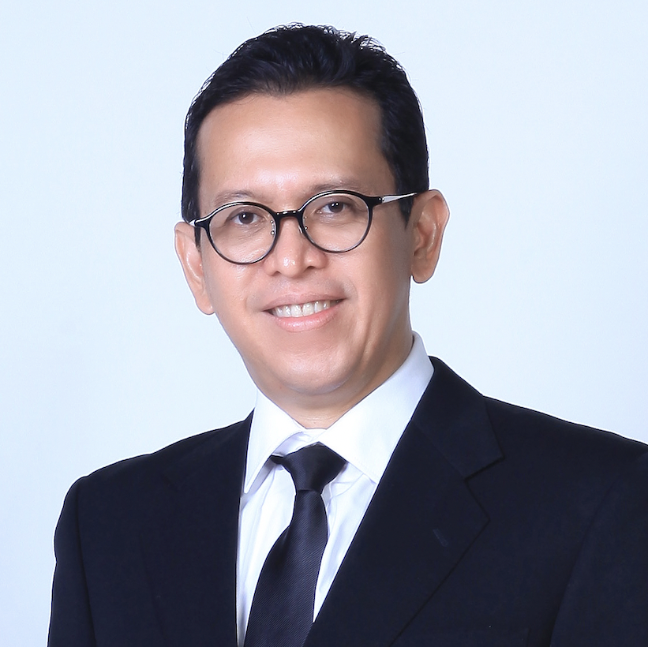
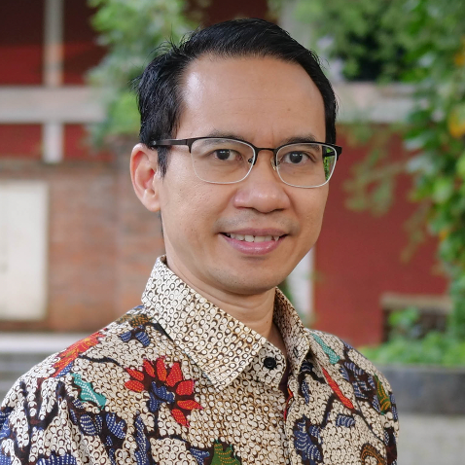
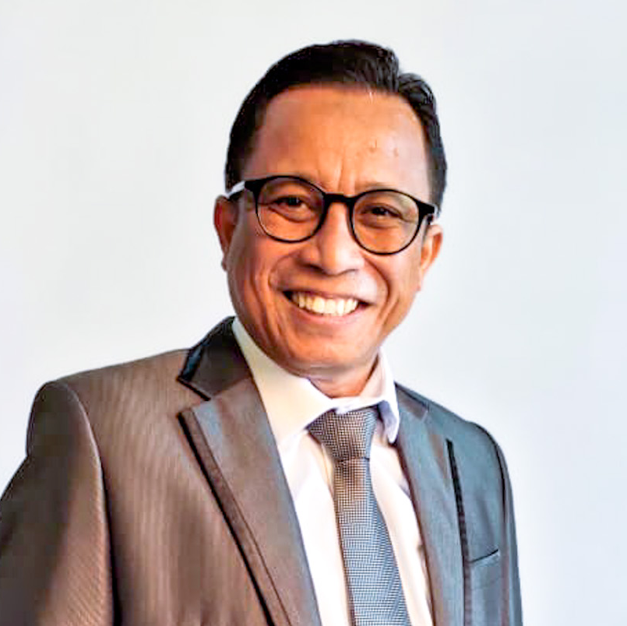
Dr. Bondan Kanumoyoso, S.S., M. Hum.
Dr. Untung Yuwono, S.S.
Dr. Taufik Asmiyanto, S.S., M.Si.
Dean of
Faculty of Humanities
Universitas Indonesia
Vice Dean of Academic, Research, and Student Affairs
Faculty of Humanities
Universitas Indonesia
Vice Dean of Resource, Venture, and General Administration
Faculty of Humanities
Universitas Indonesia

Slide 9
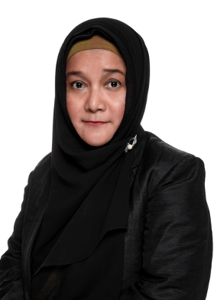
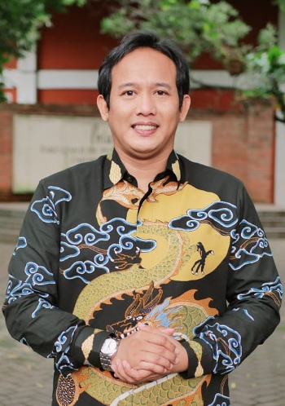
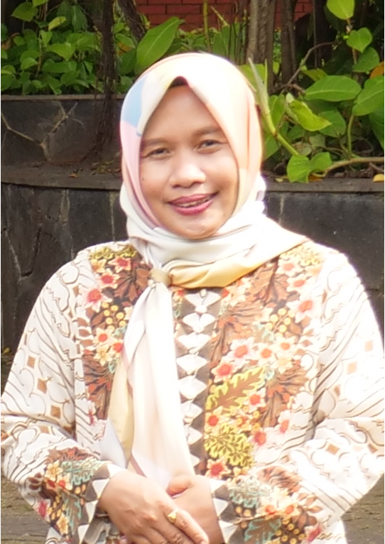
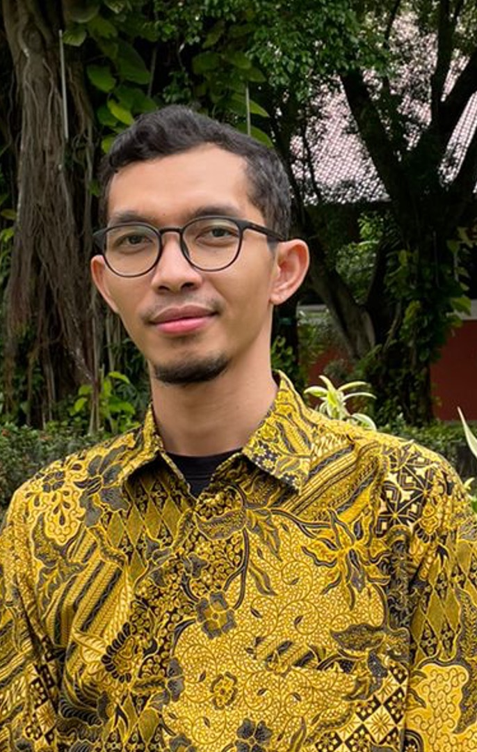
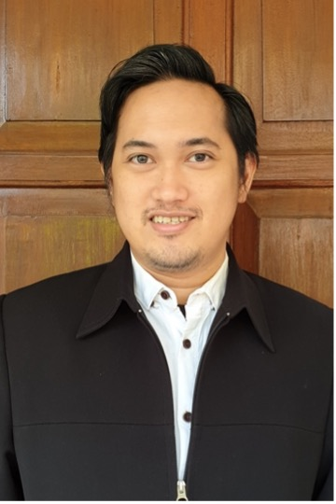
Our Person in Charge
PiC of Capacity Building
Dr. Tamara Adriani Salim, M.A.
PiC of Construction
Dr. Hendra Kaprisma, S.Hum.
PiC of Venture
Eva Latifah, Ph.D.
PiC of MOOC System and Equipment
M. Hanif Inamullah, M.Si.
PiC of MOOC Program Development
Damar Jinanto Danusastro, M.Hum.

Slide 10

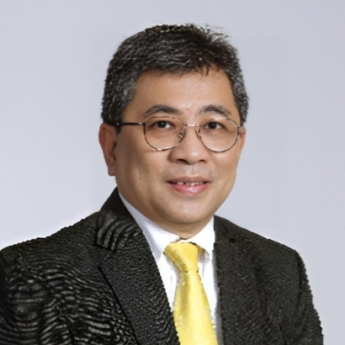
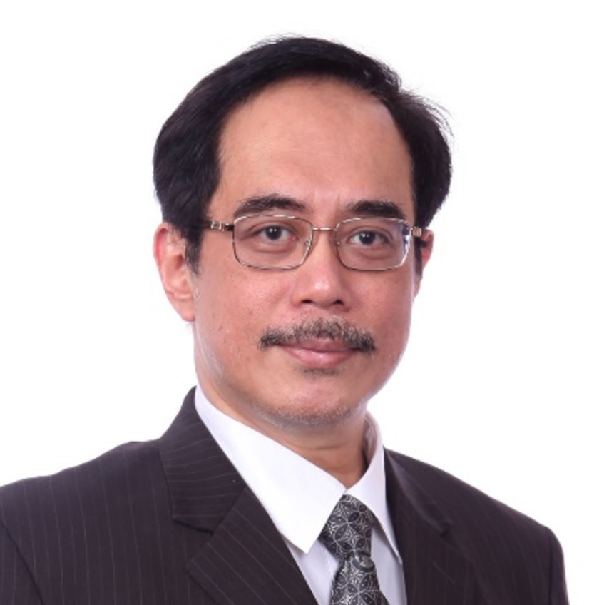
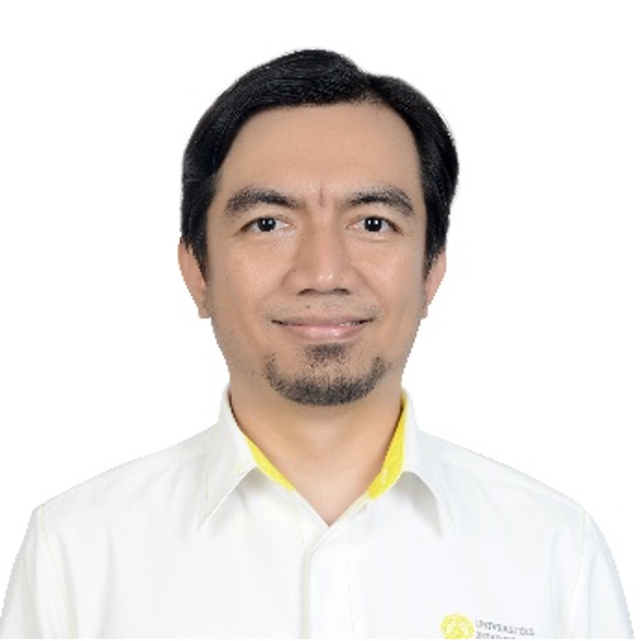
Gatot Fatwanto Hertono, Ph.D.
F. Astha Ekadiyanto, S.T., M.Sc.
FA Triatmoko HS, S.Psi., M.Si.
Director of Academic Development and Learning Resources,
Universitas Indonesia
Head of Center for Independent Learning, Universitas Indonesia
Head of Academic Reputation Enhancement, Directorate of Academic Development and Learning Resources Universitas Indonesia

Slide 11
Construction for connectivity hub
Reported by
Dr. Hendra Kaprisma, S.S.
General Manager, Faculty of Humanities UI
PiC of Construction

Slide 12





Construction of C-Hub Building
Progress – Achievements and Issues
Creating consortium partnerships with local entities can be a successful strategy
Successful implementation of comparable projects could help secure the desired contract
Previous experience working in the region/country or relevant sectors can offset the lack of local contacts
Meeting specific characteristics and associated conditions required for participation is crucial
Reviewing project requirements is important to ensure alignment with operational capabilities
PIC: Dr. Hendra Kaprisma, S.Hum.

Slide 13
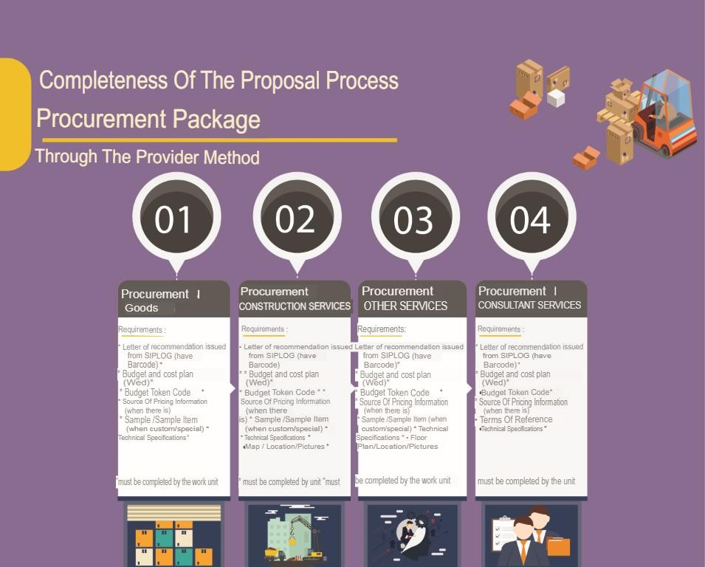
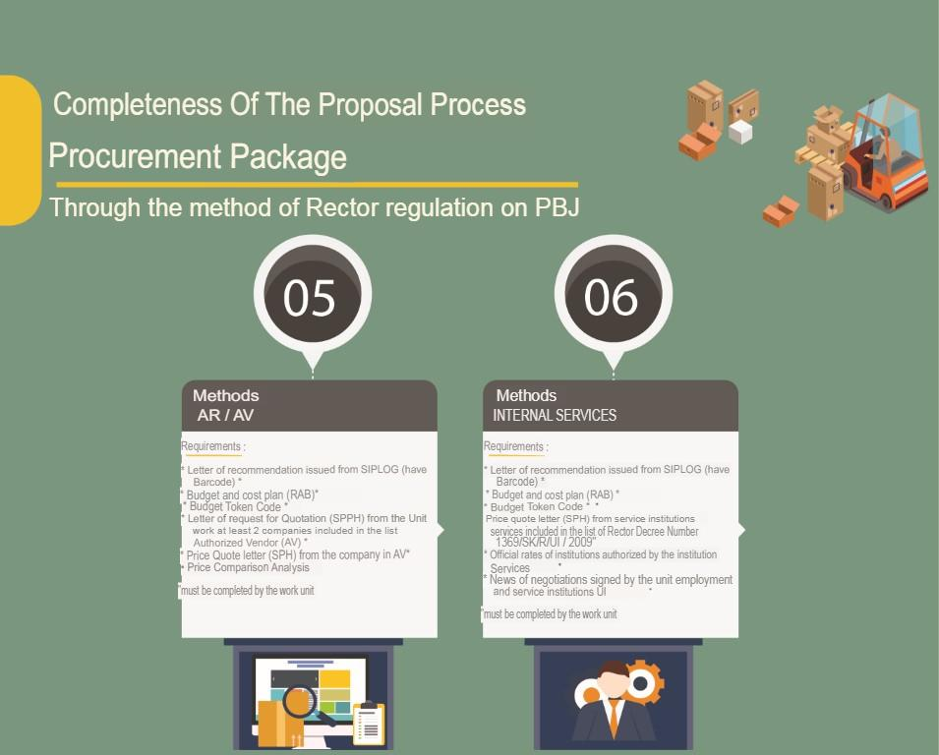
Completeness of the Proposal Process
PIC: Dr. Hendra Kaprisma, S.Hum.

Slide 14
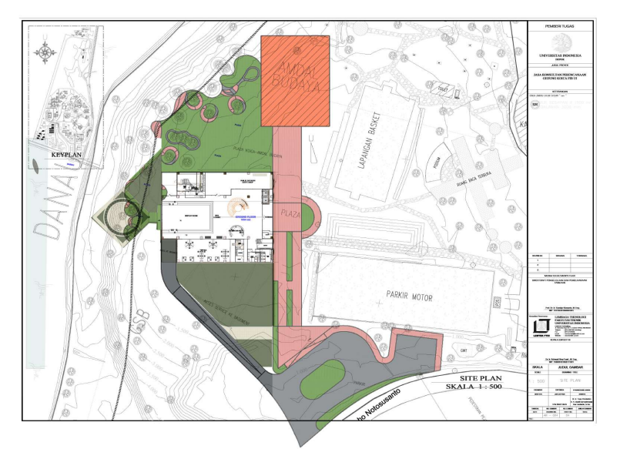
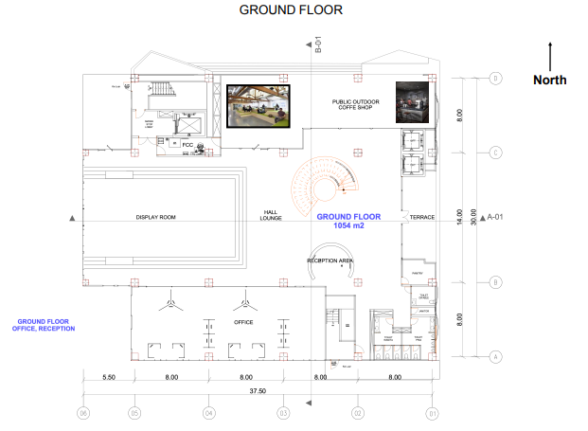
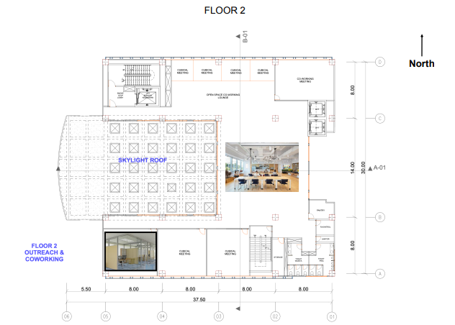
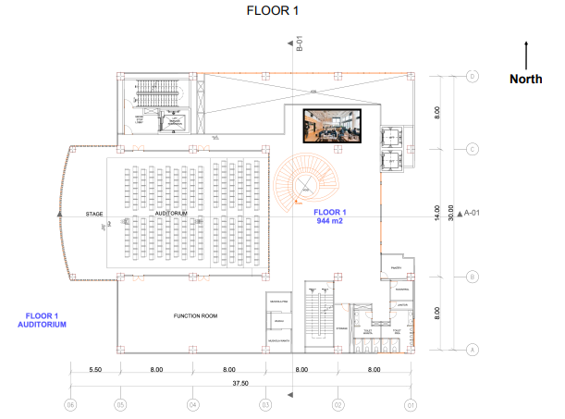
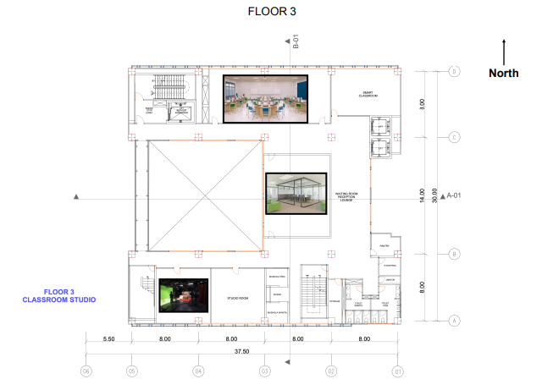
Site Plan
PIC: Dr. Hendra Kaprisma, S.Hum.

Slide 15
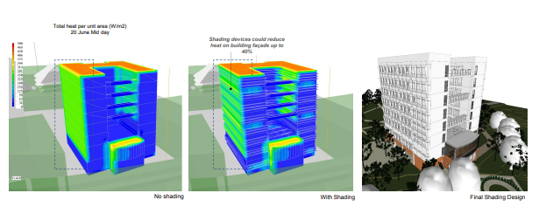
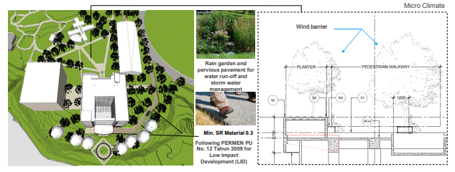
Green Strategy
Responsive building morphology
Higher façade performance
maintaining microclimate
Restoring green areas
Optimizing daylight
Reduce run-off and rainwater harvesting
Improving open space and connectivity
PIC: Dr. Hendra Kaprisma, S.Hum.

Slide 16
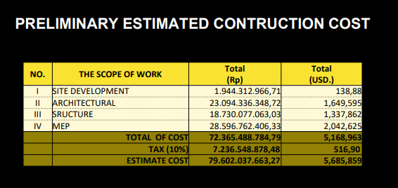
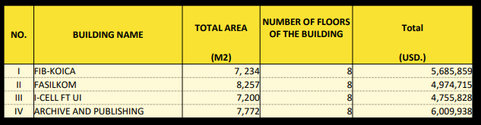
Preliminary Estimated Construction Cost
Preliminary Estimated Construction Cost
Comparison to Other Building Construction Cost At University Of Indonesia
PIC: Dr. Hendra Kaprisma, S.Hum.

Slide 17
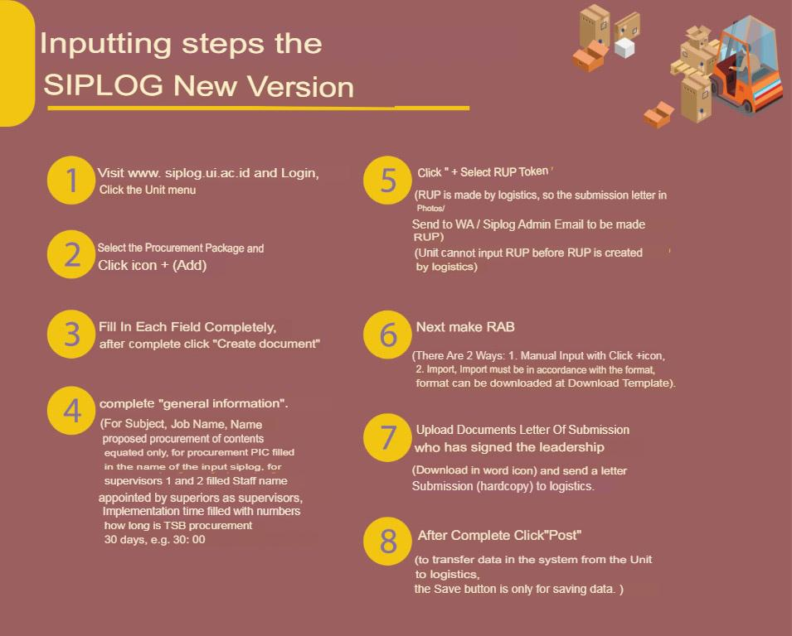
Input Steps in SIPLOG
PIC: Dr. Hendra Kaprisma, S.Hum.

Slide 18
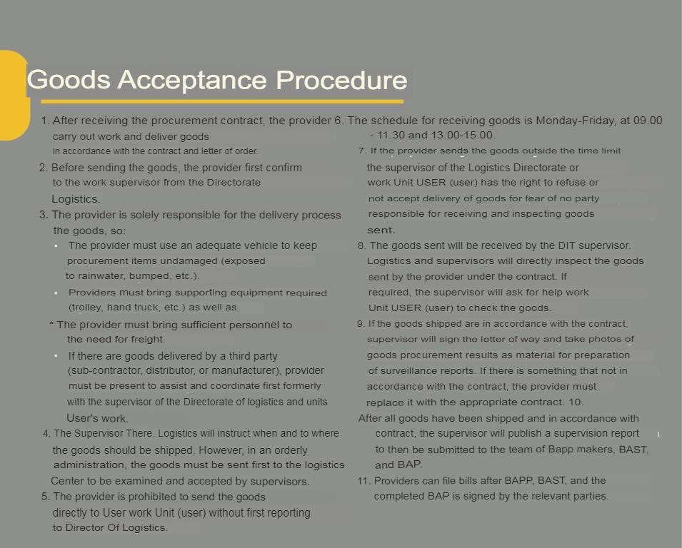
The Goods Acceptance Procedure
PIC: Dr. Hendra Kaprisma, S.Hum.

Slide 19
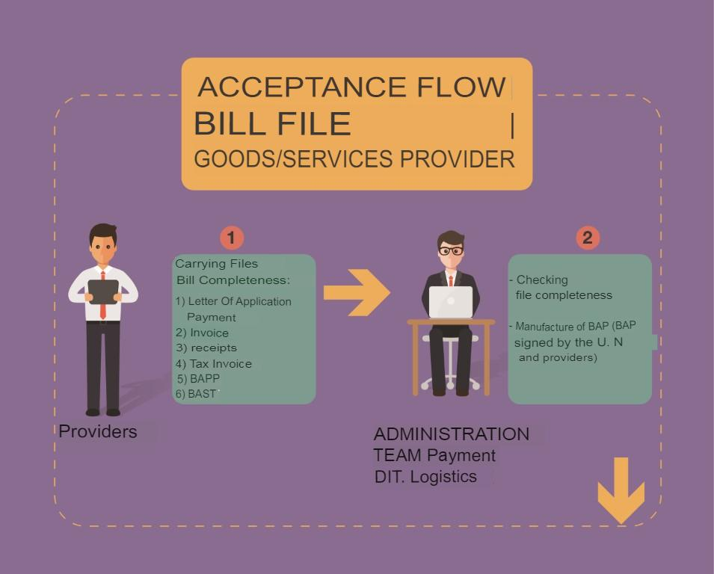
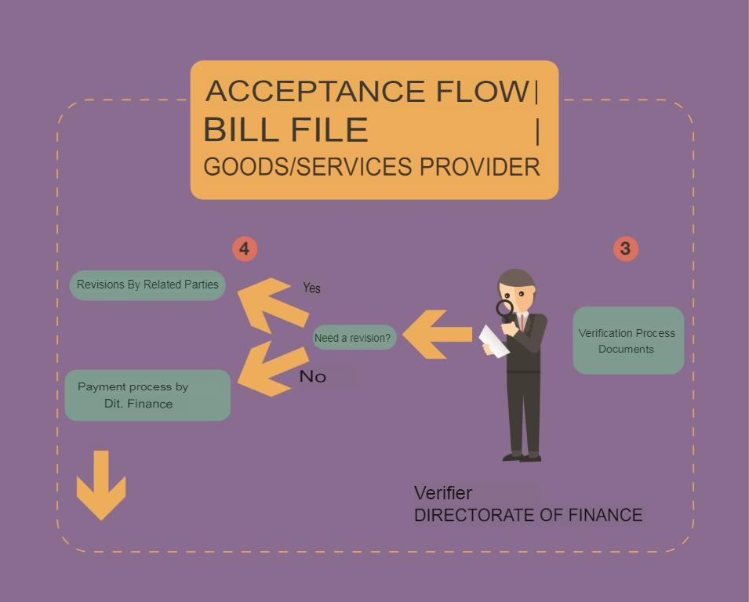
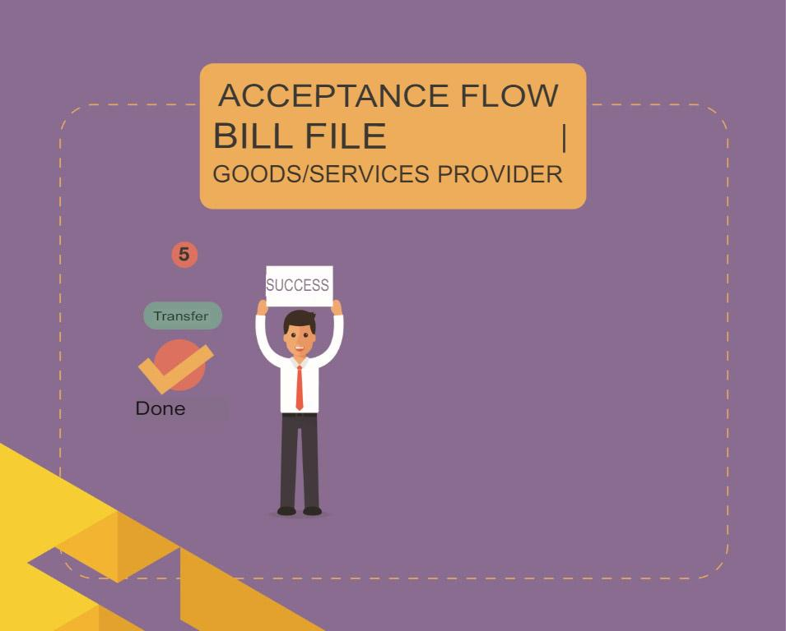
Receipt of Provider Invoice File
PIC: Dr. Hendra Kaprisma, S.Hum.

Slide 20
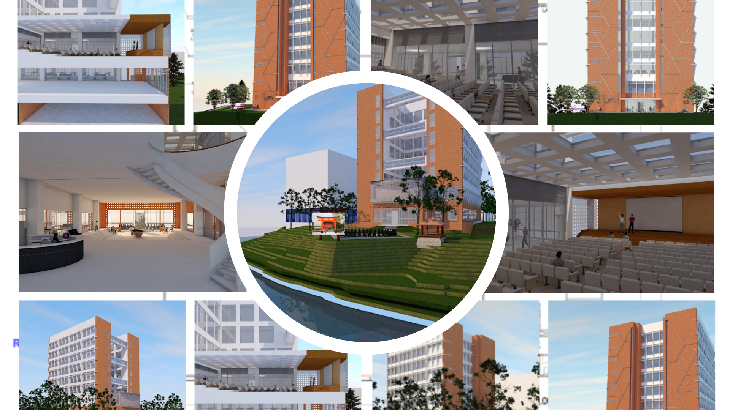
Building Design

Slide 21
Capacity building for connectivity hub
Reported by
Dr. Tamara Adriani Salim, M.A.
Manager of Human Resources, Faculty of Humanities UI
PiC of Capacity Building

Slide 22
Roadmap to operational c-hub with a quality MOOC program (Current)
Project Milestones
10/100
Master Plan for C-Hub
C-hub Building w/Equipment
Check!
Operation of C-Hub
Competent Operating Staff
Meetings/
Participants
Check!
5,000
2,000
10,000
4,000
MOOC System
active users
course completions
MOOC Dev. Guideline
10 MOOCs
Check!
20 MOOCs
36 MOOCs
New Literacy Modules
Competent Teaching Staff
Competent Teaching Staff
Competent Teaching Staff

Slide 23
Roadmap to operational c-hub with a quality MOOC program (recommendations)
Project Milestones
10/100
Master Plan for C-Hub
Operation
Manual for C-Hub
(esp. Living Lab)
C-hub Building w/Equipment
Check!
Functional Living Lab
Operation of C-Hub
Competent Operating Staff
Meetings/
Participants
System Requirements for MOOCs
RFP for MOOC System
Check!
RFP for Equipment
5,000
2,000
10,000
4,000
MOOC System
active users
course completions
Plan for C-hub MOOC Program
MOOC Dev. Guideline
10 MOOCs
Check!
20 MOOCs
36 MOOCs
New Literacy Modules
Competent Teaching Staff
Competent Staff for Content Development
Competent Teaching Staff
Competent Staff for Content Development
Competent course management Staff
Competent Teaching Staff
Competent Staff for Content Development
Competent course management Staff

Slide 24
Roadmap to operational c-hub with a quality MOOC program (recommendations)
Project Milestones
10/100
Master Plan for C-Hub
Operation
Manual for C-Hub
(esp. Living Lab)
C-hub Building w/Equipment
Check!
Functional Living Lab
Operation of C-Hub
Competent Operating Staff
Meetings/
Participants
System Requirements for MOOCs
RFP for MOOC System
Check!
RFP for Equipment
5,000
2,000
10,000
4,000
MOOC System
active users
course completions
Plan for C-hub MOOC Program
MOOC Dev. Guideline
10 MOOCs
Check!
20 MOOCs
36 MOOCs
New Literacy Modules
Competent Teaching Staff
Competent Staff for Content Development
Competent Teaching Staff
Competent Staff for Content Development
Competent course management Staff
Competent Teaching Staff
Competent Staff for Content Development
Competent course management Staff
Options
for effectiveness & sustainability
Options
for effectiveness & sustainability
Capacity Requirements
Project Management & Governance
Design, Plan, Implement a MOOC Program
Business Administration
Operation and Maintenance of C-hub facilities
Marketing and Promotion
Recruit
Appoint existing staff
  Balance workload
  Train
Outsource & establish a longer-term biz rel.
Instructional Design
Content Production
Assessment
Effective online teaching
Course Management
MOOC System Operation
System Development (Customization)
Quality Assurance
Course & Learning Management
Learner Support/Facilitation
Quintuple Helix Collaboration
Business Development
Social Innovation and Socio-preneurship
Identifying & Defining New Literacies
Outreach and Engagement

Slide 25
Focus of capacity building (’23~24)
’23
Leadership & Project Implementation Unit
Vision, goals, targets, strategies and guiding principles (as the core components of the Master Plan)
Individual action plan is the output at the end
Invitational Training
Project Management & Governance
Design, Plan, Implement a MOOC Program
Instructional Design
Content Production
Assessment
Effective online teaching
Local Capacity Building Activities
Quintuple Helix Collaboration
Business Development
Social Innovation and Socio-preneurship
Course Management
MOOC System Operation
’24
Invitational Training
Instructional Design (adv.)
Content Production (adv.)
Assessment (adv.)
Effective online teaching (adv.)
Course Management (adv.)
MOOC System Operation (adv.)
System Development (Customization)
Local Capacity Building Activities
Business Administration
Operation and Maintenance of C-hub facilities
Marketing and Promotion
Outreach and Engagement
Quality Assurance
Course & Learning Management
Learner Support/Facilitation
Identifying & Defining New Literacies

Slide 26
Invitational training goals & objectives
Leaderships
are expected to:
PIU, Project Implementation Unit
Identify social issues and challenges that UI should focus with C-hub
Explain lessons learned from preceding cases and implications for the project
Articulate Vision of C-hub
Define goals and set targets
Formulate strategies & develop guiding principles for planning and implementing the project
Each member develop an individual action plan for the project and C-hub
Propose potential collaboration or connectivity projects with Korean Institutions
Same as the Leadership
Develop a detailed plan that are readily executable for:
  Master Plan development
  capacity building activities
  development of Massive Open Online Education System (MOOC system in short)
  C-hub business model development
  other project components

Slide 27
Venture for connectivity hub
Reported by
Eva Latifah, Ph.D.
Manager of Cooperation and Venture, Faculty of Humanities UI
PiC of Venture

Slide 28



C-Hub Programs
(Community Outreach and Engagement, USR, etc.)
Pre-Launch
Launch
Post-Launch
Promote program (website, short info, video cut, etc.)
Contact partners: Korean Embassy in Indonesia, Indonesia Embassy in South Korea, Korea Foundation, Korindo, Kyung Hee University, Korea University, Pai Chai University, etc.
Alumni networking
Media partners: Hanin News
UI and FIB social media
Partners
Alumxni
Students
Evaluation of program
Promotion of building: usage, rent, co-working space

Slide 29






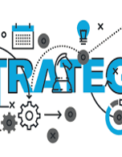



Marketing
Strategy
Disseminate standardized metrics
Foster holistically superior methodologies
Planning
Design
Launch
Synergize scalable e-commerce
Market research
Market map
Coordinate e-business applications (such as midtrans)
Deploy strategic networks with compelling e-business needs

Slide 30
TIMELINE
Q1
* Synergize scalable e-commerce
* Listing Key Institutions (state/private organizations, cummunities, NGO’s for possible partnership)
Q2
* Coordinate e-business applications
* Sending partnership proposals
Q3
* Deploy strategic networks with compelling e-business needs
Q4
* Disseminate standardized metrics
* Setting up Co-working Groups

Slide 31

AREAS OF FOCUS
B2B MARKET SCENARIOS
SERVICES
CLOUD-BASED OPPORTUNITIES
Develop winning strategies to keep ahead of the competition
​Capitalize on low hanging fruit to identify a ballpark value
​Visualize customer directed convergence​
Paid Courses
​Material Development
Consulting
Information
Co-working
Iterative approaches to corporate strategy
​Establish a management framework from the inside​

Slide 32
MOOC system development for connectivity hub
Reported by
Hanif Inamullah, M.Si.
Head of Data Management and Service, Faculty of Humanities UI
PiC of Equipment and MOOC Information System

Slide 33
MOOC System Development
Progress – Achievements and Issues
Achievements
ISSUES
Early MOOC System Development’s RFP has been drafted by Pai Chai Team (Based on December 2022 discussion)
Collaboration with other stakeholders (DPSADP, CIL, and DSTI).
Pai Chai Team proposed OpenEdX as MOOC System
C-Hub Team take a glance and a brief comparison between OpenEDX and Moodle as an LMS/MOOC System.
UI Academia and staffs are not familiarized with OpenEDX
User experience research need to be conducted
Comparison and benchmarking with other LMS/MOOC system and online learning platforms

Slide 34
PLAN FOR MOOC SYSTEM DEVELOPMENT
SYSTEM DEFINITION
SYSTEM RESEARCH
SYSTEM DESIGN
SYSTEM DEVELOPMENT
TEST AND LAUNCH
Defining and determining the goal of MOOC system including stakeholder PoV, mapping the system value and sketching the concept
Research on MOOC user’s experience, best practice, benchmarking with other MOOC platform and feasibility study.
Designing MOOC system, including system architecture and UI System based on system definition and research resulT.
Developing the MOOC system by identifying system requirements, database, back-end and front-end system development, and programming
UX and UI testing, compatibility testing, stress testing, and launching.

Slide 35
TIMELINE
Q1
System Definition and User Research
Q2
MOOC System Design
Q3
MOOC System Development
Q4
MOOC System Testing and Implementation

Slide 36
AREAS OF FOCUS
SYSTEM DEFINITION AND USER RESEARCH
DECISION ON LMS SOFTWARE
The most important thing to focus on is what this MOOC system is, its function, and its position between any other LMS UI has already have.
Do comparison and benchmarking with other LMS that has already been used by other institutions.
​Conduct a user experience research and analysis to capture end-users needs.
Decision need to be made as early as possible on which LMS software C-Hub will use as a platform for MOOC.

Slide 37
MOOC program and promotion for connectivity hub
Reported by
Damar Jinanto Danusastro, M.Hum.
Head of Training and Scientific Meetings Subdivision
Center for Social and Cultural Research
PiC of MOOC Course Development and Promotion

Slide 38
Development of C-Hub MOOC Programs & Promotions
Progress – Achievements and Issues
Results from workshop
Achievements
Issues
4 courses to develop:
Cross Cultural Management in the Workplace
Student’s Leadership Skills Development
Entrepreneurship Development Program
Married Women Empowerment through Indonesian Traditional Culinary
knowledge from experts
collaboration with CIL, DPASDP, DSTI, ICE Institute
Format: courses in MOOCs are different from academic courses in universities.
standard minimum quality
“openness” means making user friendly MOOCs to everybody
lack of human resources

Slide 39
PLAN FOR MOOCs Programs
MARKET RESEARCH
MOOCs CONTENTS
MOOCs DESIGN
HUMAN RESOURCES
PROMOTION
Evaluating from UI’s MOOCs and targeting the effectiveness of the MOOCs by user’s needs.
Providing any expertise of our lecturers, not only the regular courses in our universities
deciding the template of video, esp. the bumper in/out, content display, video format and making the user-friendly contents
Recruiting screenwriter, producer, director, videographer, sound engineer, editor, system operator, helpdesk person
using the networks and partners, social media influencers, partnership programs with industries to gain the users

Slide 40
TIMELINE
2023
Q1
Research, workshops from experts
Q2
MOOCs design, guide book, scenario template for lecturers, and production 18 MOOCs
Q3
Launch 18 MOOCs
Q4
Evaluation and preparing for 22 MOOCs next year

Slide 41
AREAS OF FOCUS
MOOCs CONTENTS
HUMAN RESOURCES
Develop the contents based on user needs and lecturer’s expertise.
maintain the good quality of the MOOCs design.
recruit the competent staff for pro-production, production, and post-production.

